Slide 1
From Curiosity to Action
How to implement Gen AI in your organization

Slide 2
1.
3.
INTRODUCTION OF SPEAKERS
OVERVIEW IN GILBERT
Micah and Eugene to share background and experience.
2.
Leveraging structure and framework with a human-centric approach.
4.
OVERVIEW IN MARICOPA
INTERACTIVE DEMO
A framework for an organic implementation model
Prompt exercise with tools such as Chat GPT, Bing Chat, and several others
Table of contents

Slide 3
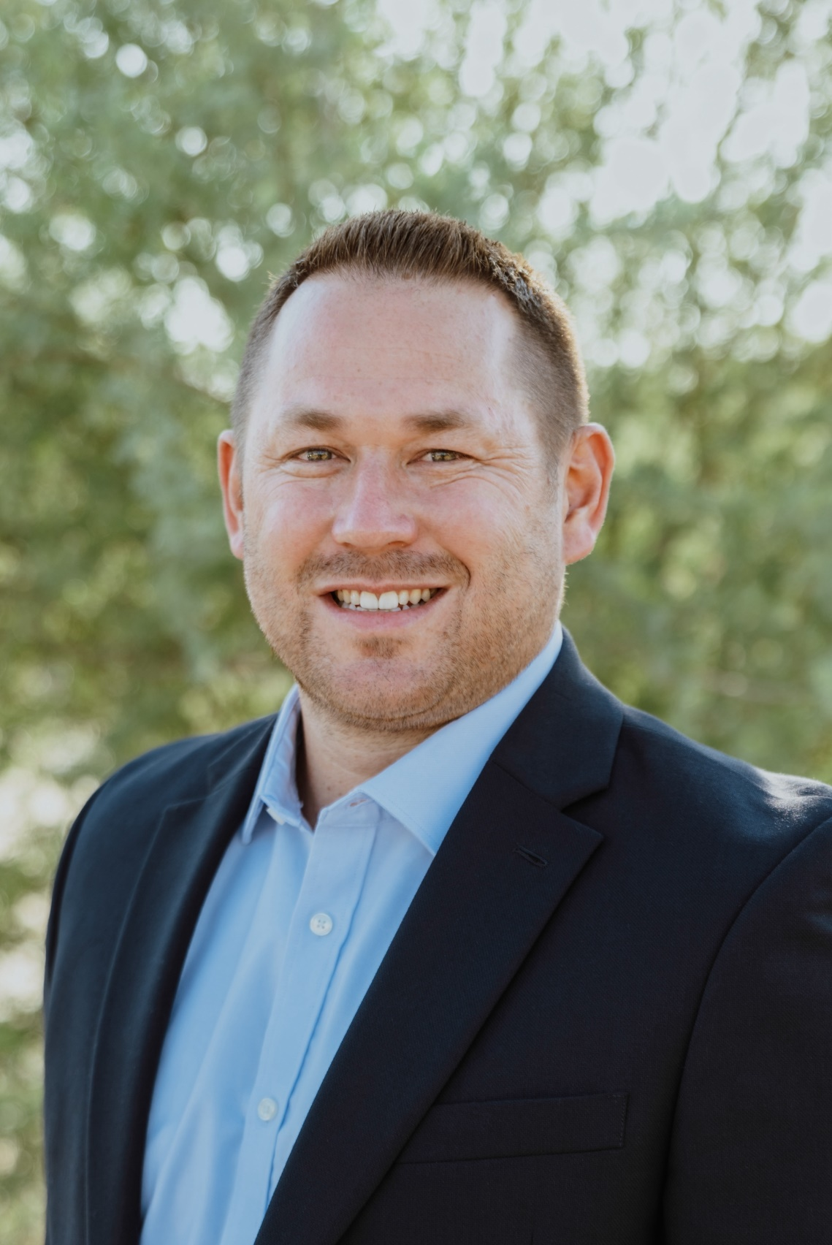
The speakers
Eugene Mejia
Micah Gaudet, Deputy City Manager and Chief Public Safety Officer (Left) & Eugene Mejia, Chief AI Strategy and Transformation Officer (Right)
Micah Gaudet

Slide 4
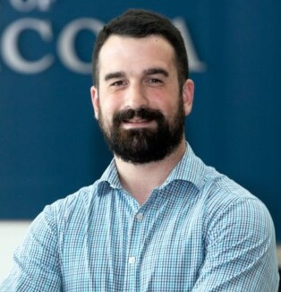
MICAH’S BIO…
Micah Gaudet serves as the Deputy City Manager/Chief Public Safety Officer for the City of Maricopa, AZ. He is the nation’s leading voice on applying generative AI in local government. His innovative approach and influential social media presence have significantly contributed to the practical use of AI in the public sector. Micah is the creator of the first-ever generative AI course specifically designed for local governments, a program that has gained popularity in over 50 U.S. cities including Dallas, TX, Liberty Lake, WA, and Tempe, AZ.
He is the founder of the AI in Local Government Network, an impressive group with over 220 members representing 190 local governments worldwide, including cities like Buenos Aires, Argentina, and London, UK, as well as nearly every state in the US. Micah's pioneering work in this field has made him a sought-after speaker at local government conferences and led to a partnership with Strategic Government Resources.
Micah Gaudet
Deputy City Manager/Chief Public Safety Officer
City of Maricopa
Holding a B.S. in Economics from Middle Tennessee State University and an MA in Public Administration from The Johns Hopkins University, Micah is a vanguard in melding AI with government services. He challenges the status quo and advocates for innovative solutions to ensure a sustainable future. His achievements and visionary perspective establish him as a luminary in the sphere of forward-thinking local government administration.

Slide 5
EUGENE’S BIO…
Eugene has 16+ years of experience in Local and County government Information Technology. During that time, he has held multiple leadership roles supporting Public Safety and Municipal environments. Eugene has served as Gilbert's first Deputy and Assistant Chief Technology Officer focused on driving digital transformation across the enterprise centered around the Customer Experience.
He has been with Gilbert 11 years leading efforts to strategically align IT's Roadmap and Cloud Strategy to the Town’s ‘City of the Future’ vision. His latest role is another first, serving as Gilbert’s Chief AI Strategy and Transformation Officer, where he will be working in partnership with various departments and regional stakeholders, both public and private, to develop a vision in this space.
Eugene Mejia
Chief AI Strategy & Transformation Officer
Town of Gilbert
Eugene is currently serving as a member on the Dell State & Local Government Advisory Board and the Adobe Cloud Customer Advisory Board.

Slide 6
“The elements of danger are with us,
and the questions of safeguards demand the most careful consideration by our municipal authorities.”

Slide 7
Fear of A.I.
“One of the biggest problems [we] face is coping with the abundance of technologies in the marketplace. It’s hard for executives to figure out what all those …applications…do, let alone decide…how to successfully adopt them.”
“So far as the influence…upon the mind and morals of the people is concerned, there can be no rational doubt, that [it] has caused vast injury. Superficial, sudden, unsifted, too fast for the truth.”
“You will also find…they will completely neglect to mention any of [its] liabilities. We need to proceed with our eyes wide open so that we many use technology rather than be used by it.”
“[It] has its limitations, and its perspective is invariably false.”

Slide 8
Fear of All Inventions
One of the biggest problems companies face is coping with the abundance of technologies in the marketplace. It’s hard for executives to figure out what all those …applications…do, let alone decide…how to successfully adopt them. – HBR (2006) on IT networks
So far as the influence…upon the mind and morals of the people is concerned, there can be no rational doubt, that the telegraph has caused vast injury. Superficial, sudden, unsifted, too fast for the truth. – NYT (1858)
You will also find…they will completely neglect to mention any of [its] liabilities. We need to proceed with our eyes wide open so that we many use technology rather than be used by it. –UC Davis (1997) on computers
Photography has its limitations, and its perspective is invariably false – The Atlantic (1887)

Slide 9
What’s happening in Maricopa
An Organic
Implementation Model
The City of Maricopa prides itself as an organization committed to hiring, retaining, and promoting talent. We have a talented team, so I can trust and empower them to use Gen AI tools in safe, constructive ways that meet the mission and objectives of the City.
Talent
The right person, on the right bus, in the right sight, and the wrong people off
Trust
Right people, right bus, right seats—trusted to decide rightly
Thrive
Trusting our team, we empower innovation aligned to the City’s mission.
It all comes down to talent

Slide 10
“The elements of danger are with us,
and the questions of safeguards demand the most careful consideration by our municipal authorities.”
- The Atlantic on automobiles in 1890

Slide 11
What’s happening in Gilbert
“Our goal is to drive efficiencies, enhance capabilities and contribute to the overall betterment of our community through a human-centric approach to the deployment of AI tools and technologies."
AI STRATEGY & ROADMAP
Governance
Skills & Knowledge
Tools
Strategic Partnerships
Action & Iteration

Slide 12
Data Classification
&
Handling Standard
WISP
Data Governance Program
Artificial Intelligence (AI) Use Standard
Acceptable Use Standard
Privacy & Security Questionnaire

Slide 13
FRAMEWORK FOR SUCCESS
 |  | 2023 Q4 | 2024 Q1 Q2 Q3 Q4
Governance | Establishing a robust and adaptable framework to maintain consistency and uniform language across the organization.
Skills & Knowledge | Prepare Gilbert employees with the knowledge, skills, and resources to work effectively and responsibly with AI tools.
Tools | Deploy solutions and establish directory of AI tools within the organization based on the AI Use Standard.
Strategic Partnerships | Foster feedback and consultations with stakeholders in both public and private sector industries around opportunities and challenges for AI.
Action & Iteration | Based on feedback from Committee prioritize list of use cases. Share those with the organization and publicize on internal site.

Slide 14
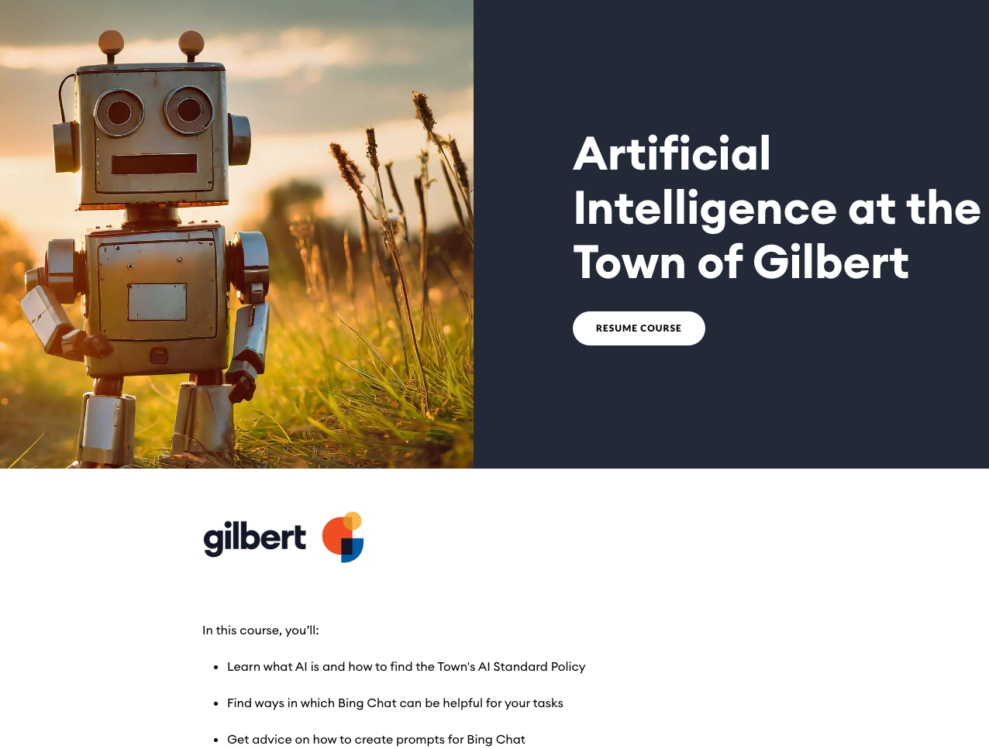
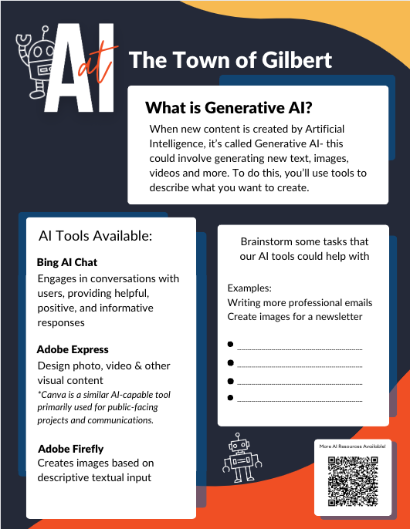
Gilbert’s AI Training

Slide 15
WHERE TO START?
 | AI BLUEPRINT (NASCIO)
1. | Align AI Initiatives to Strategic drivers for organization | AI Strategy & Roadmap
2. | Establish governance and oversight processes | NIST, WISP, AI Use Standard, AI Advisory Committee
3. | Address data quality and sourcing | Data Governance, Performance Management, Data Classification & Handling
4. | Inventory and document existing applications | AI Services & IT Service Catalog
5. | Collaborate with stakeholders & industry partners | CAISTO Role, AI Advisory Committee
6. | Address privacy and cyber risks of AI adoption | PSQ Process, Data Principles, AI Use Standard
7. | Infrastructure and technology | AI Strategy & Roadmap, IT Roadmap, Cloud Strategy
8. | Identify potential use cases | AI Advisory Committee
9. | Expand AI workforce expertise and training | Digital Course, Handout material, workshops, partner events
10. | Create guidelines for responsible use | AI Use Standard, Citation Guideline
11. | Measure and communicate effectively | Virtual Town Hall, SharePoint Site, Town Website, AI Strategy & Roadmap
12. | Create acquisition and development | PSQ Process, SaaS/COTS strategy

Slide 16
Generative AI Use Cases
Creating PowerPoints, transcribing meeting notes, drafting email responses, etc.
Augment job descriptions, interview questions, policies, etc.
Briefing and response preparation for community issues
Pressure testing ideas and content created
Image and media creation for newsletters, flyers, and internal messaging

Slide 17
chat.openai.com
Free version, great for written content
Pro: $20/month
Upload Images, Data, Docs
Use analysis, file upload, image creation in single conversations
Connected to internet for real time information
Not as good as Claude with longform written content

Slide 18
www.claude.ai
Free to use
Great for generating written content
Ability to upload documents for analysis and editing
Not connected to the internet for real-time information

Slide 19
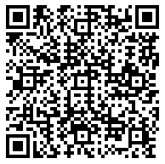
www.perplexity.ai
The ‘new google’
Great research tool
Sourced responses
Pro: $20/month
300 co-pilot searches/day
Ability to toggle AI Models
Not a content generator

Slide 20
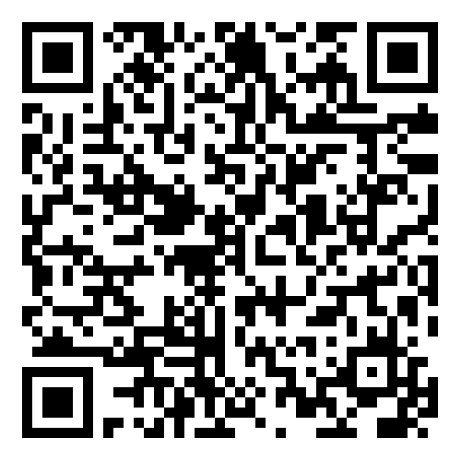
Copilot with Bing Chat
Free for public use in limited capacity
Part of Microsoft Enterprise Agreement (G3/G5)
Backed by ChatGPT-4 engine
Prompts not used in training large language model
Create content & images

Slide 21
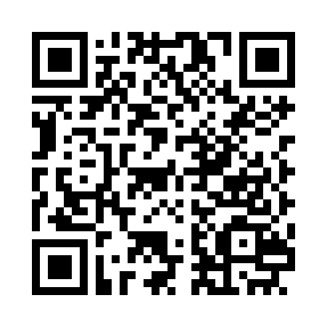
Follow along
Scan the QR code to access prompts and files for an interactive, live demonstration

Slide 22
TIME FOR DEMO!

Slide 23
Q and A
ASK AWAY!

Slide 24
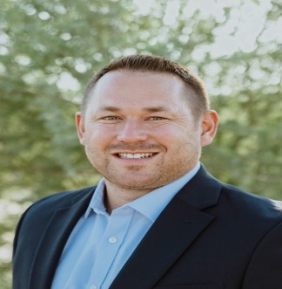
Eugene Mejia
Micah Gaudet
Get in touch
913-217-5238
micahgaudet@civicinnovation.ai
www.civicinnovation.ai
480-635-7775
Eugene.mejia@gilbertaz.gov
www.gilbertaz.gov

